Slide 1
Game Of Nim
By Aman Rauniyar and Rithy Suon

Slide 2
AMENDMENTS
Previously, we had planned to make two different levels of complexity: easy – 2 piles and hard – 3 piles to make it more challenging. But, now we are using only two piles of stone

Slide 3
Project Objectives
Understand the basic approaches to problem-solving using AI techniques
Acquiring complete knowledge in using search strategies such as the Depth First Search algorithm
Master the minimax algorithm to find the most optimal move for the AI to pick the stones from the pile
To implement the working class Game of Nim, a strategic game in a text based version
Both the players will be making their optimal moves not to remove the last stone

Slide 4
Project Description
We will be implementing the Game of Nim, a combinatorial game where we are given a number of piles in which each pile contains a certain amount of stones. The rules are in each turn a player makes they are allowed to only choose only one pile and can remove any number of stones they desire from that pile. The goal state of the game is which player takes the last move.
Using the minimax algorithm the player is referred to as the MAX and the opponent is referred to as the MIN. Both will try to maximize their moves. MAX being the player will try to maximize their score and MIN being the opponent will try to minimize MAX’s score.
The game will include 2 players- human and computer with 2 piles, 12 stones each

Slide 5
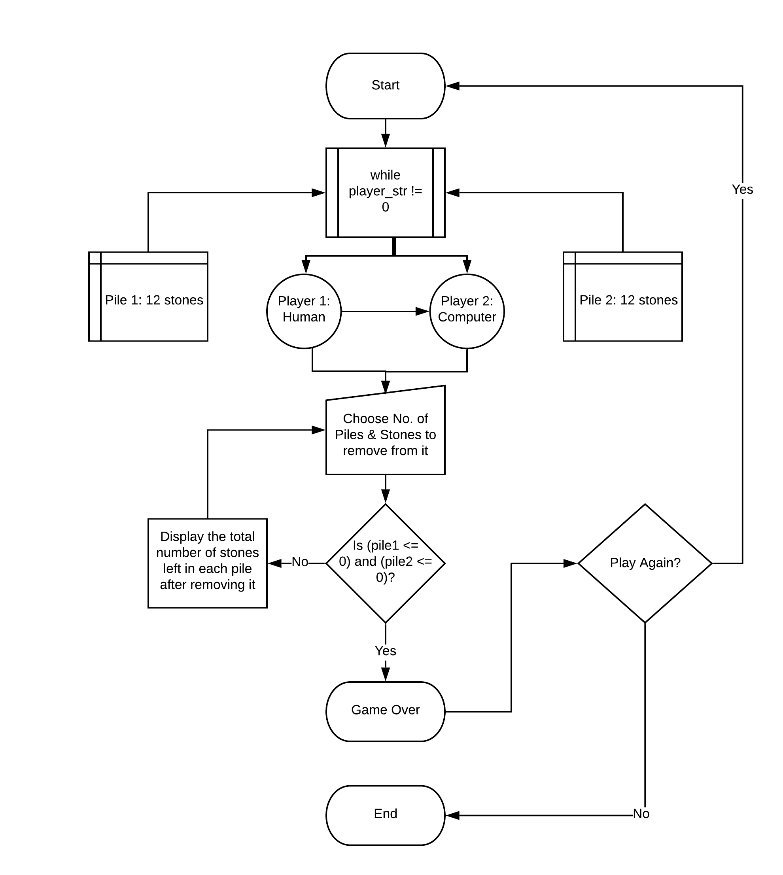
Flow diagram

Slide 6
Solution Design
Behavior of the game
Starting info - This is the constructor of the game
Asks the user whether you want to play or not
It will generate two piles, pile 1 and pile 2 with 12 stones
Two Players – Player 1: Human & Player 2: Computer
Connects the players and pile
During the game - While ! Game over
Each player gets one turn

Slide 7
Solution design cont.
During a turn
Current Player takes turn
Player 1 chooses the pile number either 1 or 2 and will be given the opportunity to remove stones first
Player 2 choose the other pile which player 1 didn’t select and will be given the opportunity to remove stones from that pile after Player 1
take a number of stones from a pile (up to 3)

Slide 8
Solution design cont.
After Each Turn
Number of stones on the pile is calculated
After each round, Player 1 is asked again to choose a pile and how many stones you want to remove
Game over
Last person to take a stone from a pile will win the game
Game over
Asks user whether you want to play again

Slide 9
Tools List
Programming language – Python
IDE – PyCharm, Spyder

Slide 10
Current Status of the Project
Completed the analysis and algorithm design
Finished writing the code in Python
And, has tested successfully to the best of our knowledge

Slide 11
Division of Work
Program analysis and algorithm design will be divided evenly
https://codepile.net/ allows us both to work on the project together

Slide 12
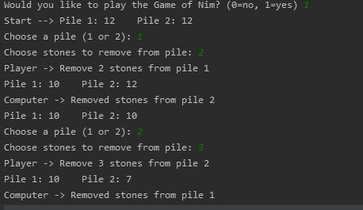
DEMO

Slide 13
References
https://elearning.salemstate.edu/courses/1290647/files?preview=83596070
http://www.cs.trincoll.edu/~ram/cpsc352/notes/minimax.html
https://www.geeksforgeeks.org/minimax-algorithm-in-game-theory-set-1-introduction/
https://www.geeksforgeeks.org/combinatorial-game-theory-set-2-game-nim/
https://www.lucidchart.com

